Slide 1
Let’s Login
Lokitha.K(B.Tech IT)
Kokila.M(B.Tech CSBS)

Slide 2


Problem
We all are know how our life gets changed due to
COVID-19.
Here is the one step solution for all problems for students
#TheNewNormal

Slide 3

The website primarily focuses on controlling the chaos inside the college campus.
It helps the college authority to maintain discipline and manage students in college in an easy way by providing an all-in-one platform for managing all kinds of activities related to students and colleges inside the college campuses.
It also helps in managing college in pandemic situations like COVID by not allowing many students to gather at one place.
Interactive ChatBot for collecting the feedback from the students

Slide 4
Working Model
Check Up and College Sanitize
Login Rights
Arrival and Leave
Website Contains
Approve leave and check the arrival
Admin Rights
College sanizization approval

Slide 5
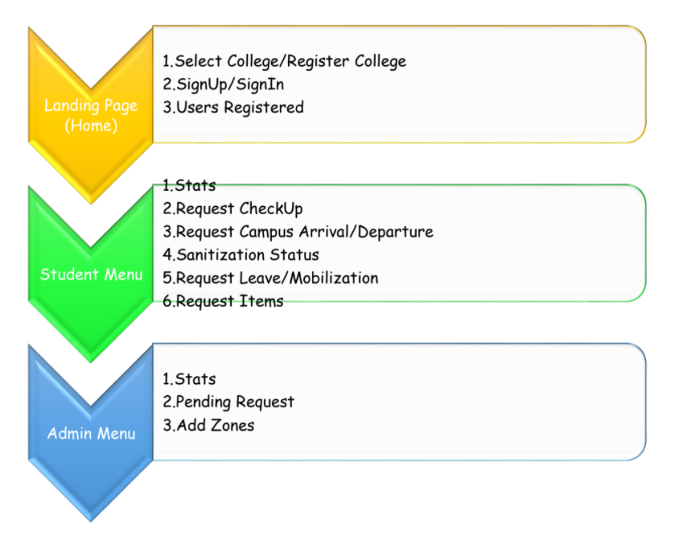

Slide 6

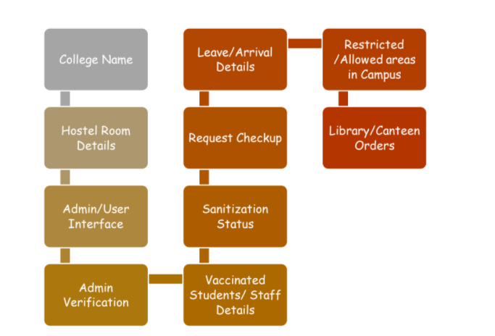

Slide 7
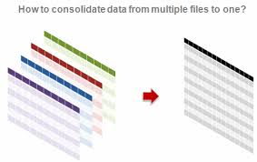
Tech Stacks
HTML5
CSS 3
BOOTSTRAP
MongoDB
Nodejs
Typescript
Heroku
Express Js

Slide 8


